Slide 1









Welcome To Tech Cohort 8 Website Presentation
Delivered by
Alex, Dan, Daren, Ryan and Vanessa
Using the following tools

Slide 2


Our Journey
First what type of business are we going to be
We unanimous in deciding on some form of coffee company
Then we had to decide on a name
So, we would like to introduce you to
DV8 Coffee Shop and Wholesaler

Slide 3
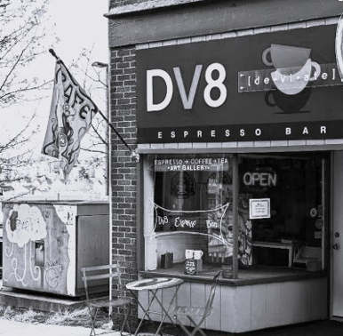


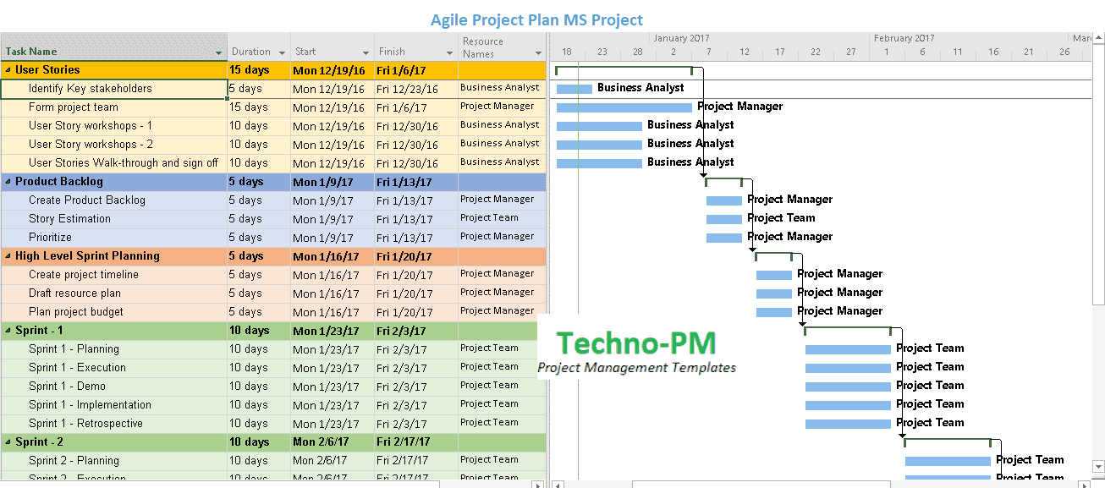
Planning
We wanted to try and use the Agile Methodology
We soon realised we could use certain aspects of the framework
However due to limited time and availability of the team we volunteered to do tasks

Slide 4
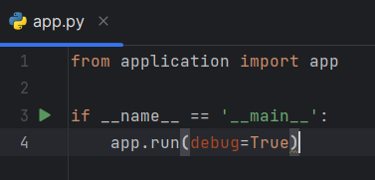
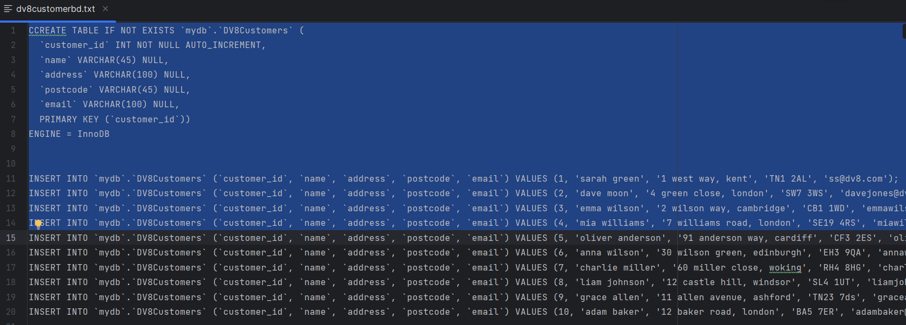
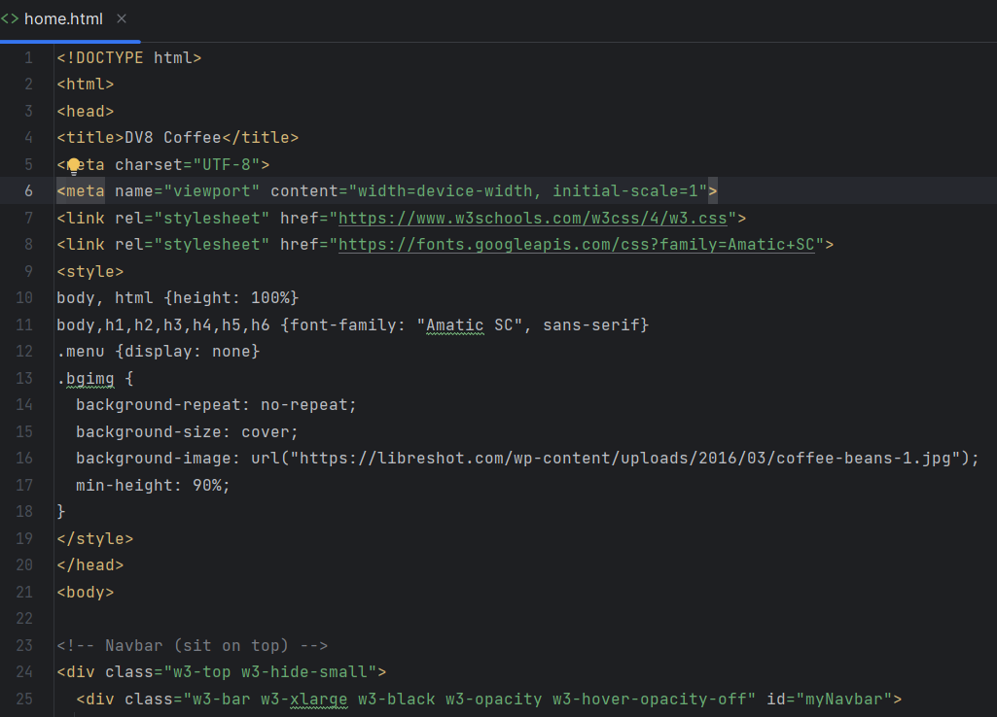
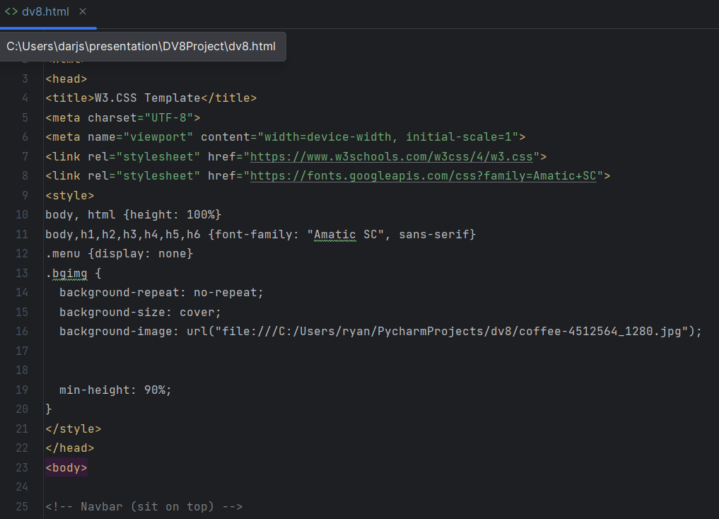
Coding

Slide 5
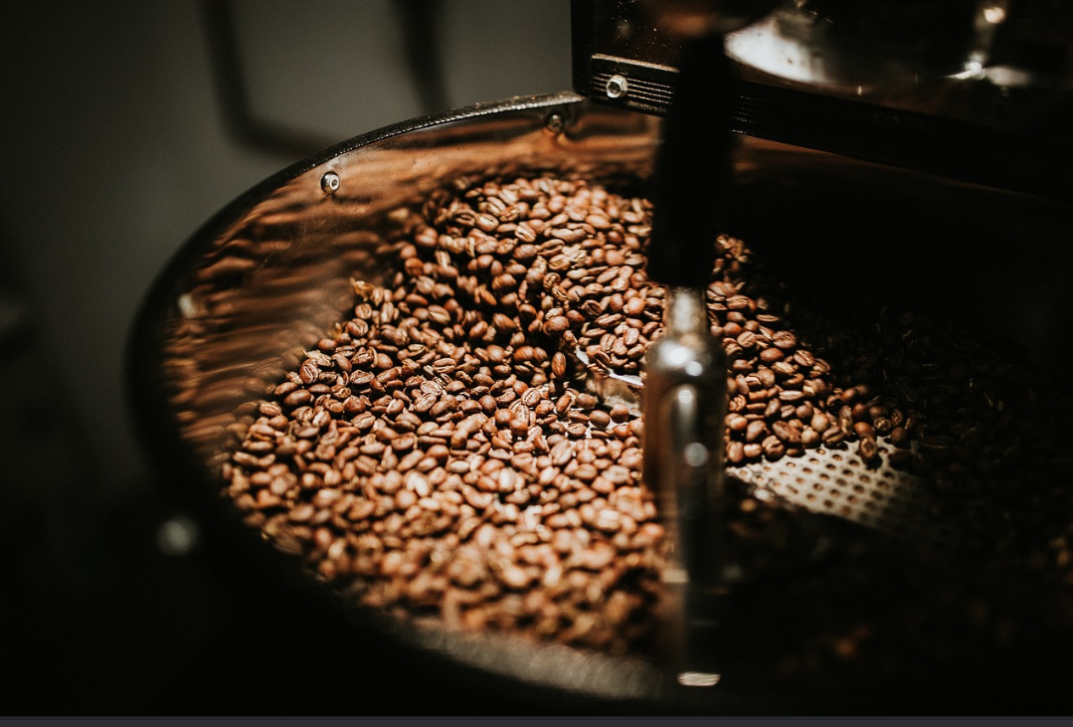
Conclusions
We soon realised you need to do your research on the name. There are a lot of DV8 companies out there
The internet is your friend
Don’t think you should know everything
TEAMWORK is everything

